Slide 1
Data Structures
Lecture 8
Recursion
Prantik Paul [PNP]
Lecturer
Department of Computer Science and Engineering
BRAC University

Slide 2
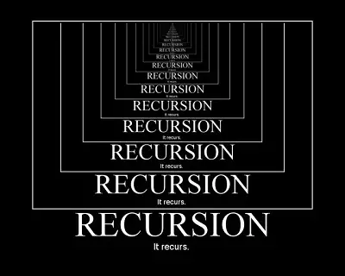
Recursion

Slide 3
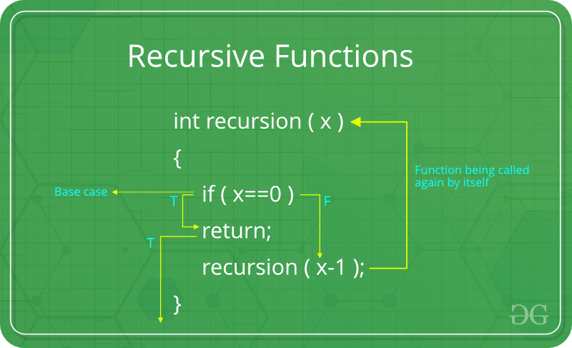
Recursive Definition

Slide 4
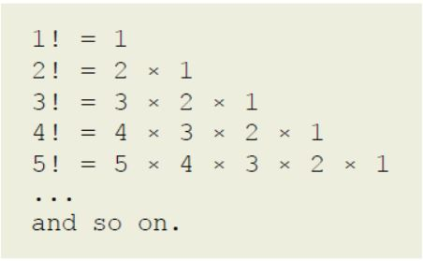
Recursive Definition (Factorial)

Slide 5
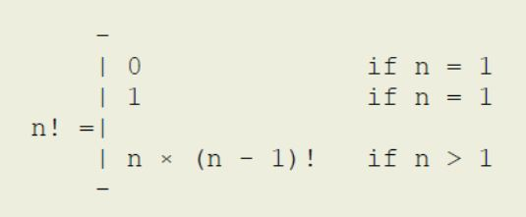
Recursive Definition (Factorial)
1
0

Slide 6
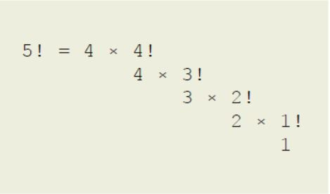
Recursive Definition (Factorial)

Slide 7
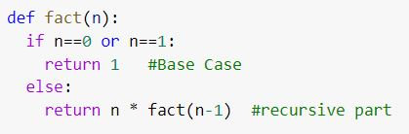
Recursive Programming (Factorial)

Slide 8
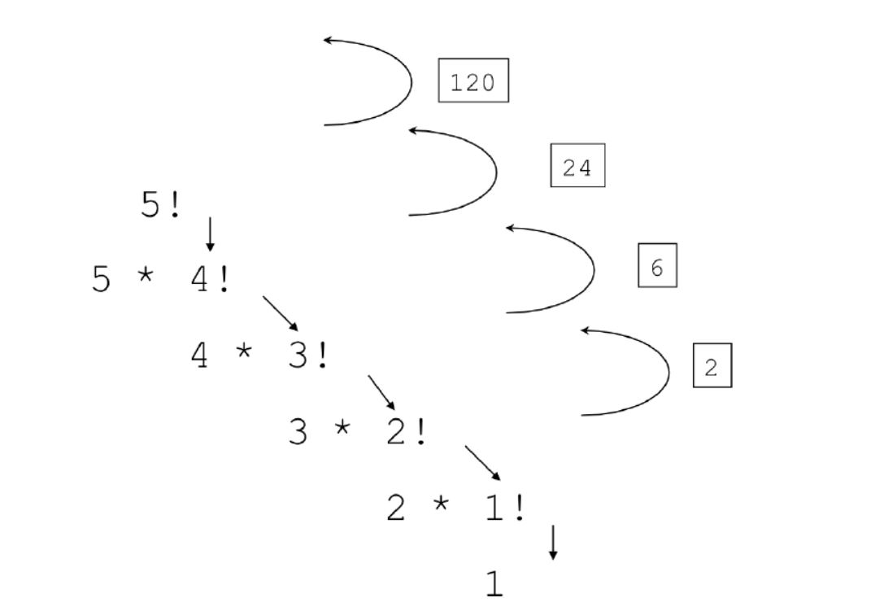
Recursion Tree (Factorial)

Slide 9
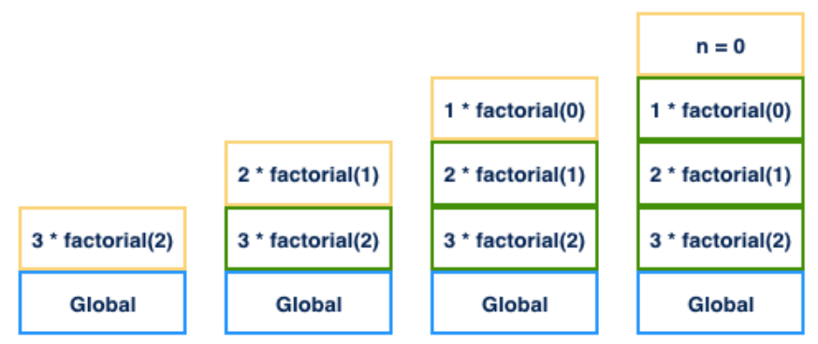
Recursion Stack (Factorial)

Slide 10
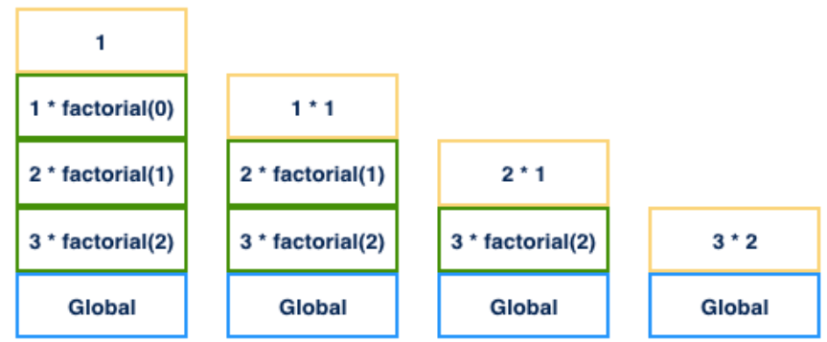
Recursion Stack (Factorial)

Slide 11
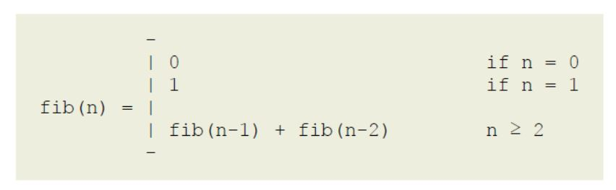
Recursive Definition (Fibonacci)

Slide 12
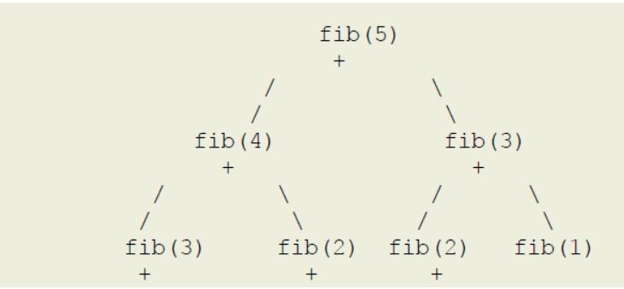
Recursion Tree (Fibonacci)

Slide 13
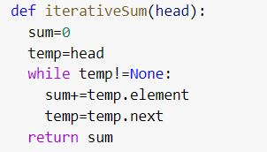
Sum of numbers

Slide 14
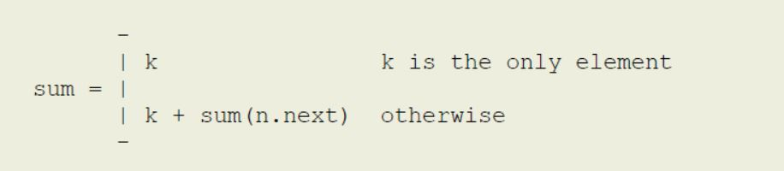
Recursive Definition ( Sum of numbers )

Slide 15
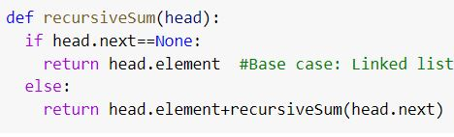
Recursive Programming ( Sum of numbers )

Slide 16
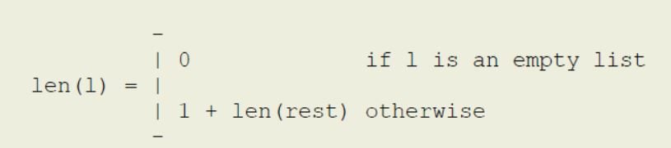
Recursive Definition ( Length of Linked List )

Slide 17
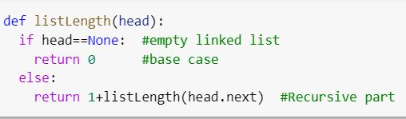
Recursive Programming ( Length of Linked List )

Slide 18
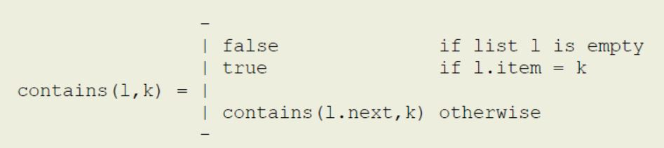
Recursive Definition ( Sequential Search LL )

Slide 19
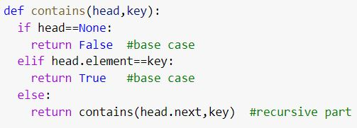
Recursive Programming ( Sequential Search LL )

Slide 20
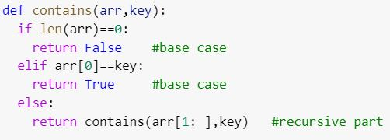
Recursive Programming ( Sequential Search Array )

Slide 21
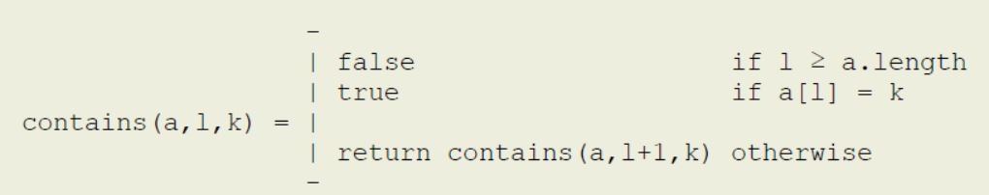
Recursive Definition ( Seq Search : Left Index )

Slide 22
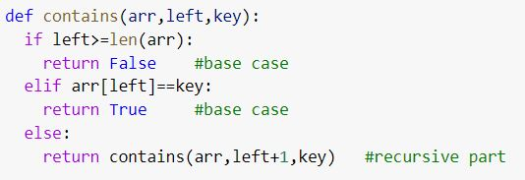
Recursive Programming (Seq Search : Left Index)

Slide 23
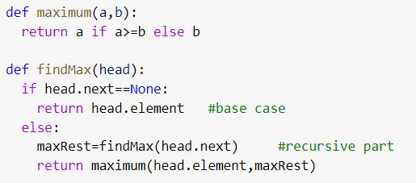
Recursive Programming ( Find Maximum - Linear LL )

Slide 24
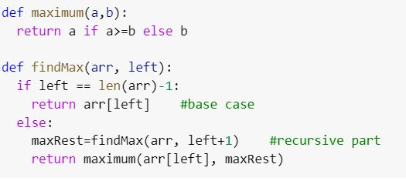
Recursive Programming (Find Maximum - Linear Array)

Slide 25
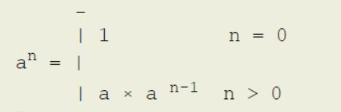
Recursive Definition ( Exponentiation )

Slide 26
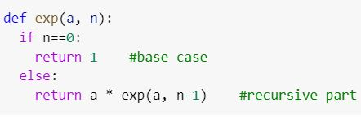
Recursive Programming ( Exponentiation )

Slide 27
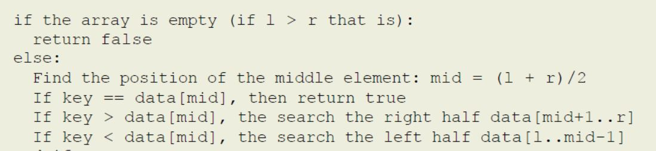
Recursive Definition ( Binary Search )

Slide 28
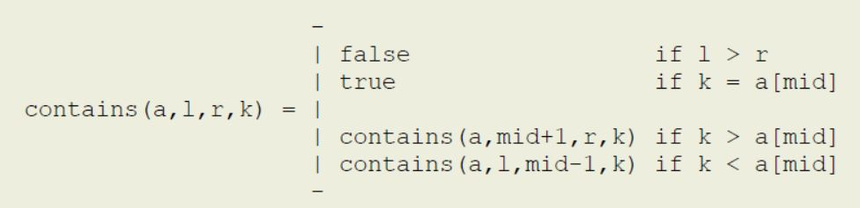
Recursive Definition ( Binary Search )

Slide 29
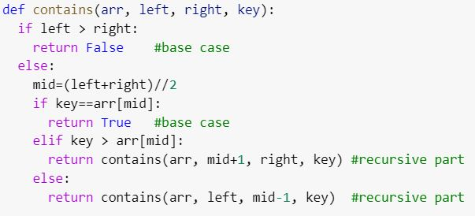
Recursive Programming (Binary Search)

Slide 30
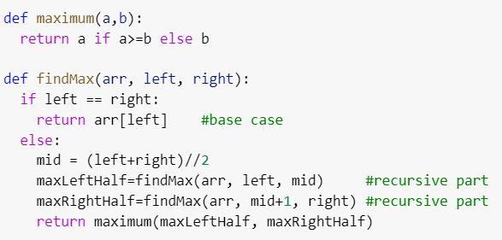
Recursive Programming (Find Maximum - Binary)

Slide 31
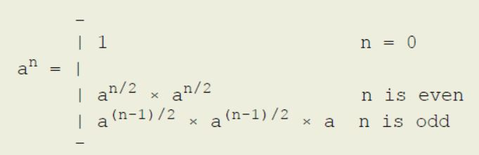
Recursive Definition ( Exponentiation Efficient )

Slide 32
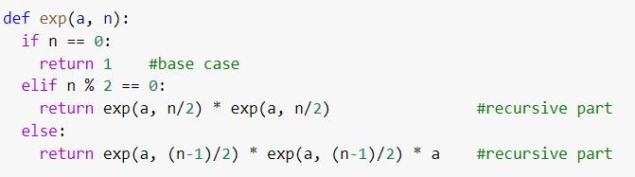
Recursive Programming (Exponentiation Efficient)

Slide 33
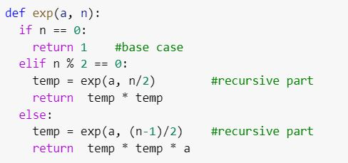
Recursive Programming (Exponentiation Efficient)

Slide 34
Recursive Programming ( Problems )
Inefficient Recursion
Space for Activation Frames
Infinite Recursion

